Slide 1

Metabolomics Data Analysis Workshop
March 18, 2019
Chunyu Ma, MS
Bioinformatics Analyst
Computational Metabolomics & Integrative Omics, Clinical Biomarkers Laboratory
Emory University

Slide 2
Overview
MetaboAnalyst
xmsPANDA
MetabNet

Slide 3
Example Data
The example dataset we used today is from a published study from Clinical Biomarker Laboratory to examine H1N1 influenza virus infection-altered metabolic response in mouse lung (Chandler, 2016). The dataset includes data for 4,567 metabolic features across 10 mice (N control=5, N H1N1=5).
Download data:
https://github.com/joneslabemory/March182019-metabolomics-analysis-workshop/tree/master/example%20data
Ref:
Chandler, J.D., et al. (2016) Metabolic pathways of lung inflammation revealed by high-resolution metabolomics (HRM) of H1N1 influenza virus infection in mice. Am J Physiol Regul Integr Comp Physiol, 311, R906-R916.

Slide 4
Tools for metabolomics data analysis
 | Case- Control | Case- Control with covariates | Repeated measurements (2-class) | Time- series | Two- factor ANOVA | Machine Learning | Correlation analysis | Ensemble feature selection | Regression
xmsPANDA R package Shiny App | ✔ | ✔ | ✔ | ✔ | ✔ | ✔ | ✔ | ✔ | ✔
MetaboAnalyst (Web-tool) | ✔ | x | ✔ | ✔ | ✔ | ✔ | ✔ | x | x

Slide 5
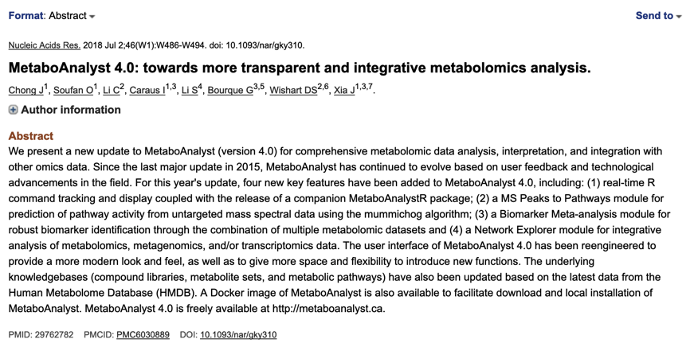
MetaboAnalyst: Web-based pipeline for metabolomics data analysis
To identify significant features within the data, we will be using the online metabolomics data processing pipeline, MetaboAnalyst 4.0
MetaboAnalyst (Wishart Research group at the University of Alberta, Edmonton, Canada)
Please go to:
https://www.metaboanalyst.ca/faces/ModuleView.xhtml

Slide 6
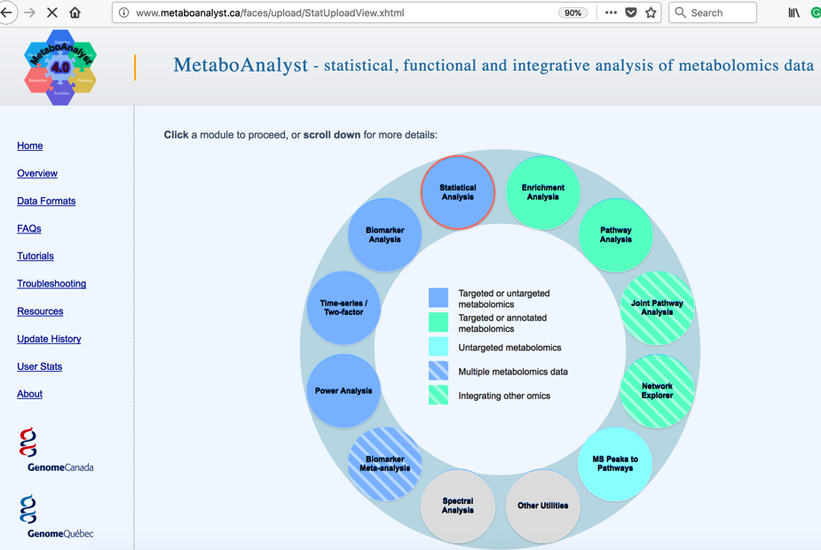
Data analysis modules

Slide 7
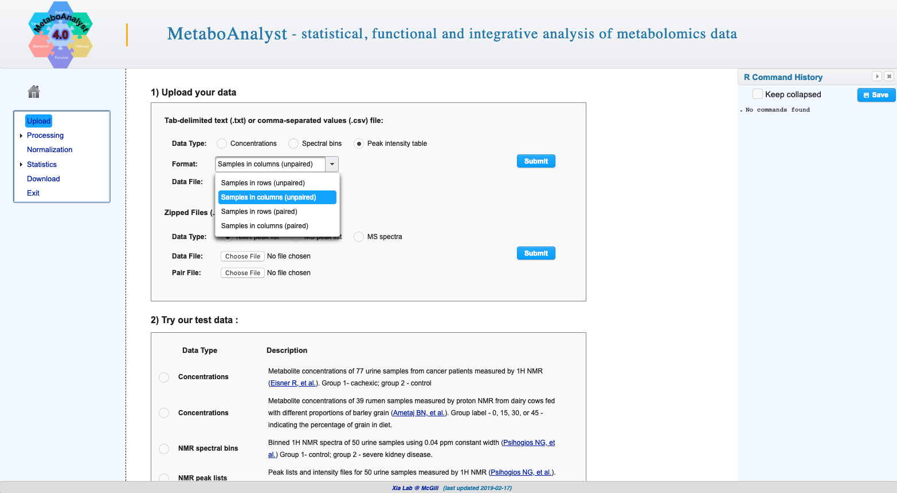

Slide 8
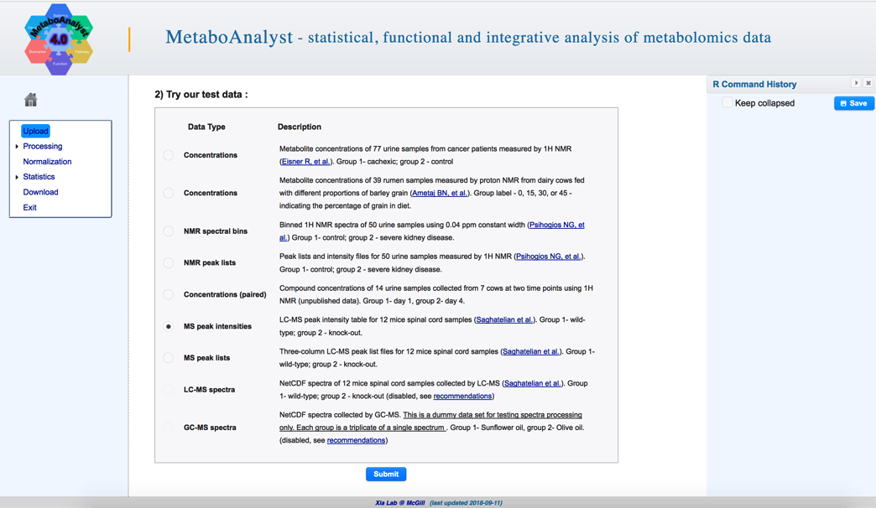

Slide 9
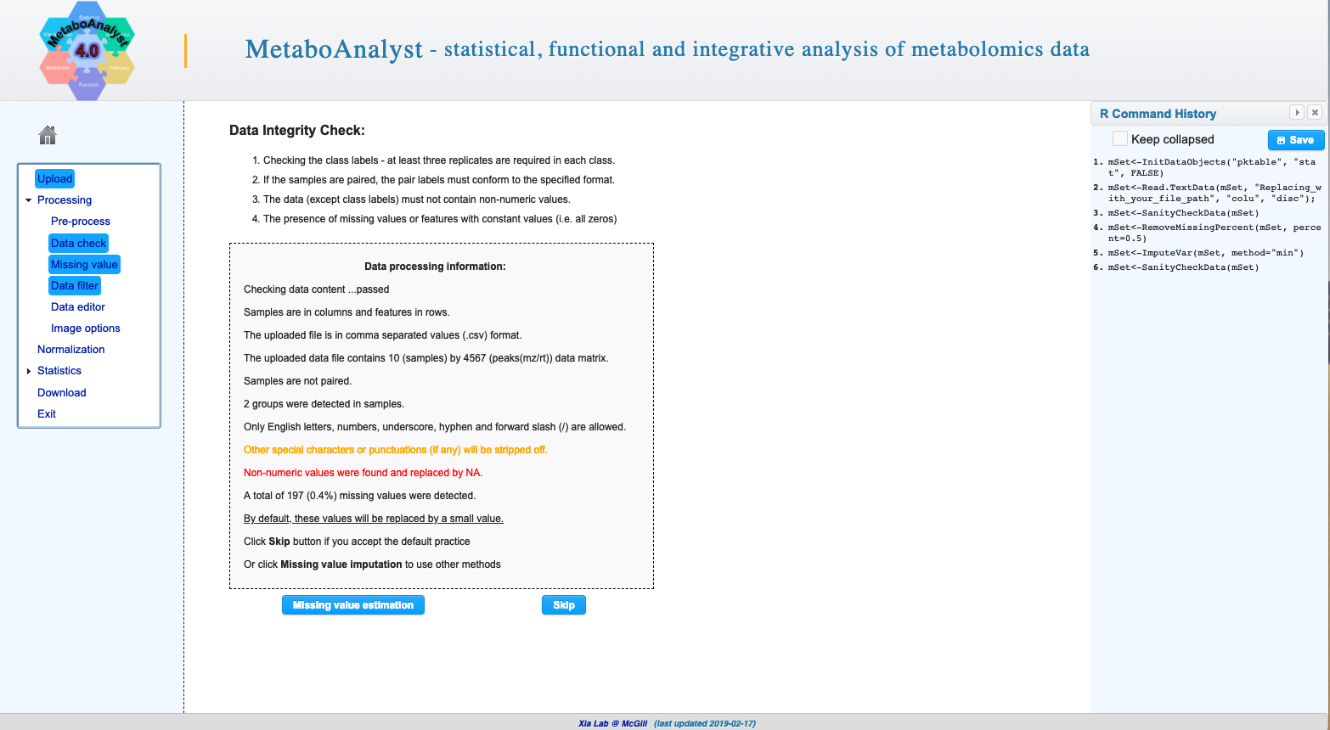
If your feature table contains missing values and set them as blank otherwise the system will consider them as a valid value.
You can try to impute your missing values

Slide 10
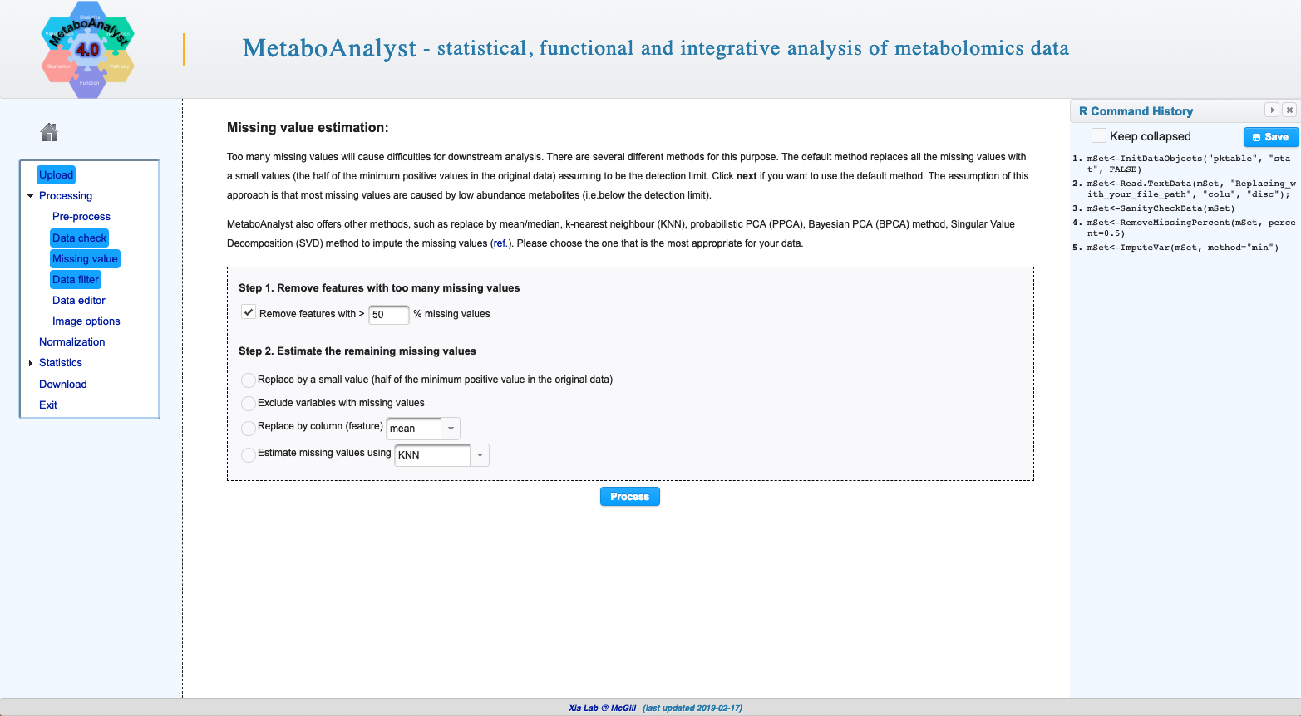

Slide 11
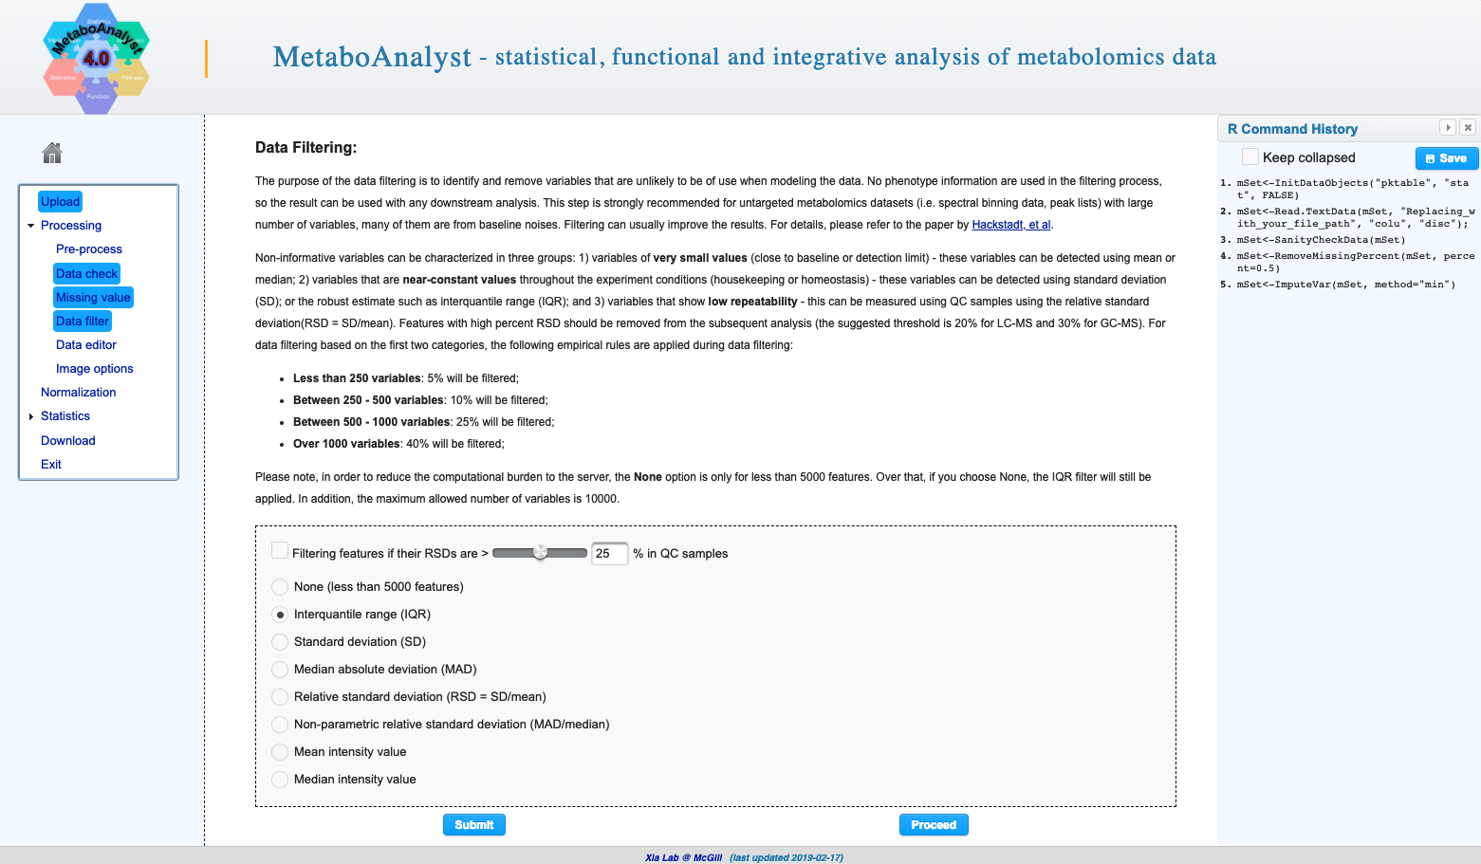

Slide 12
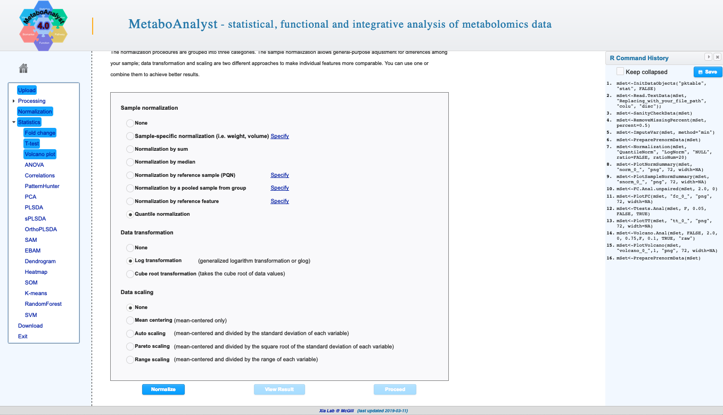

Slide 13
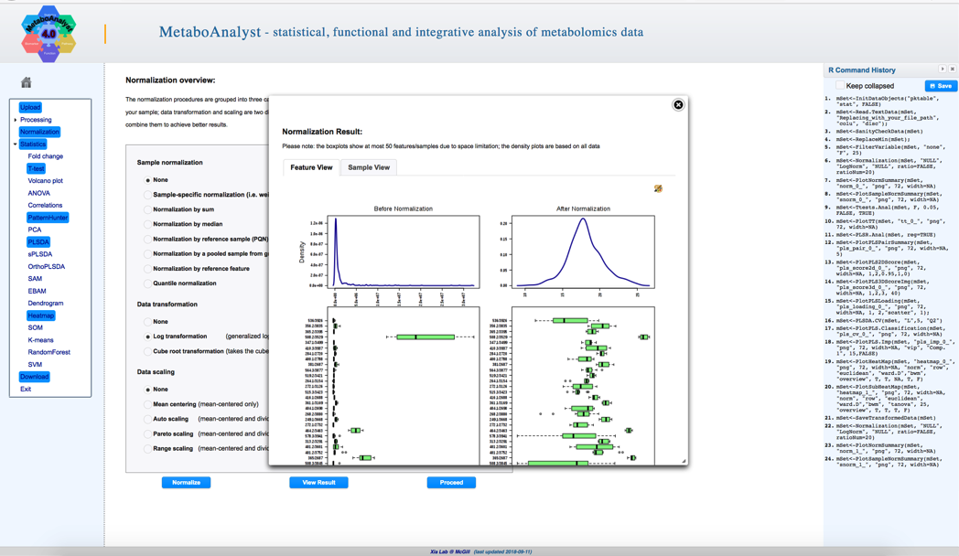

Slide 14
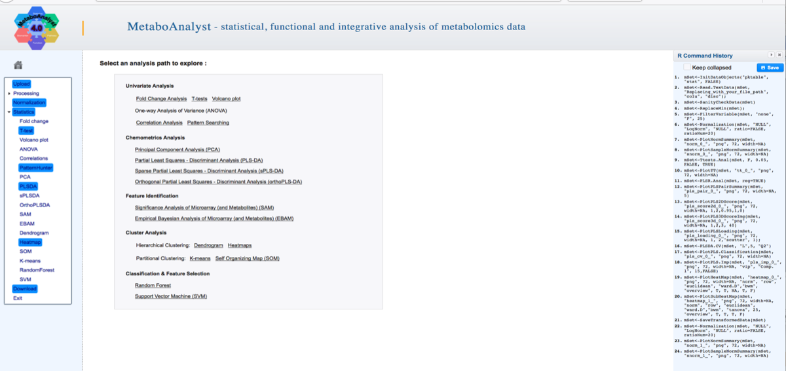

Slide 15
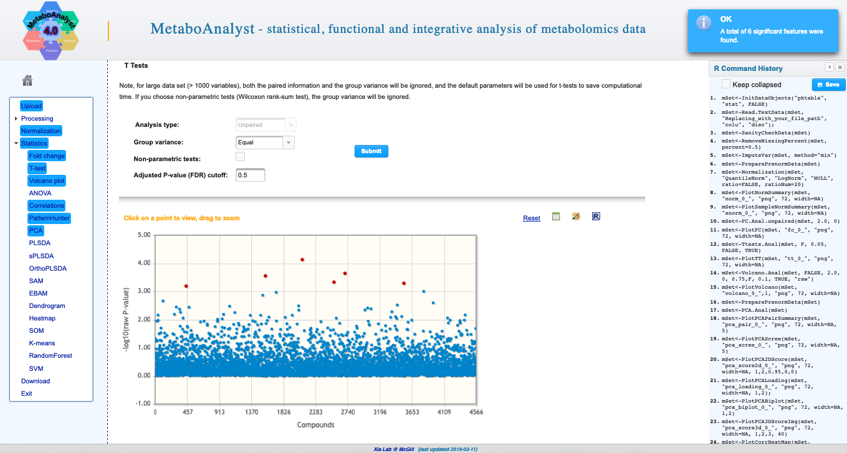

Slide 16
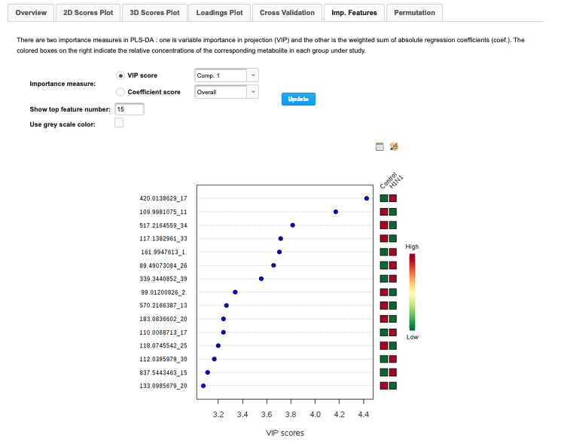
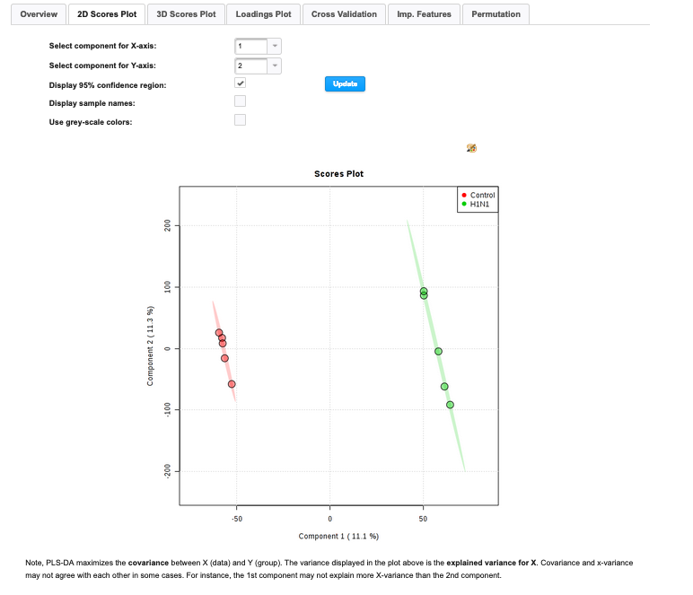

Slide 17
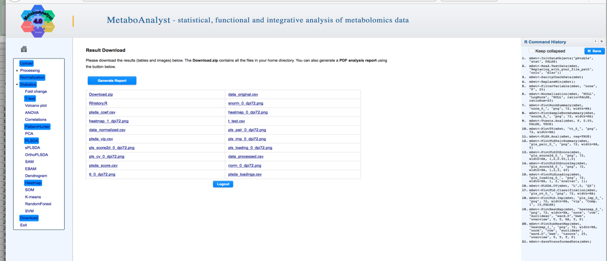

Slide 18
xmsPANDA: pre-processing, biomarker discovery, clustering, and network analysis

Slide 19
xmsPANDA basic workflow
Module a) Data pre-processing (Stage 1)
Replicate summarization
Data filtering: missing values, relative standard deviation
Data Transformation (log, z-score)
Normalization (Quantile)
Module b) Data mining (Stage 2)
Univariate: Limma t-test, paired t-test, wilcox, mixed effects model, ANOVA
Multivariate and predictive analysis for regression and classification: Support vector machine, MARS, Random forest, PLS, sPLS
Unsupervised: PCA, two-way Hierarchical clustering analysis
Module c) Metabolome-wide association (correlation) analysis (Stage 3)
Global: Pairwise correlation and network of all metabolites
Targeted: Pairwise correlation and network of targeted metabolites

Slide 20
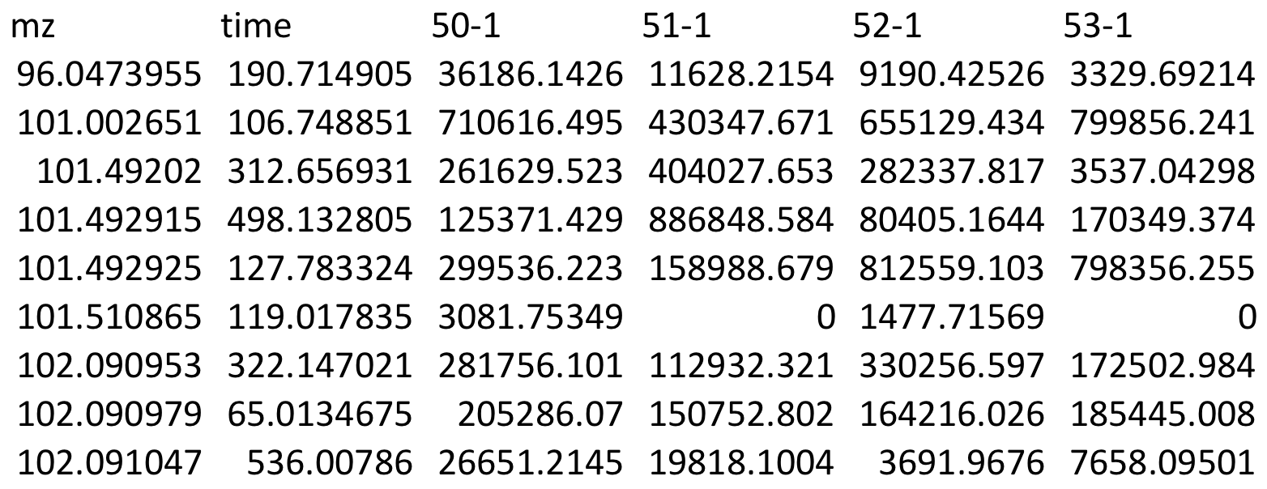
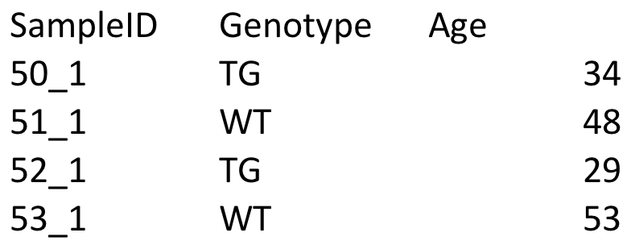
xmsPANDA: Sample input files
a. Feature table
Sample IDs
The order must be identical
b. Class labels file

Slide 21
Common functions in xmsPANDA package
Wrapper function:
diffexp function for complete analysis workflow
Additional functions:
data_preprocess function for data preprocessing
replicate summarization, filtering, transformation, normalization, imputation
get_boxplots function for generating boxplots
get_hca function for one-way or two-way hierarchical clustering analysis
get_pcascoredistplots function for principal component analysis
get_roc function for generating ROC curves
metabnet function for Pearson or Spearman correlation based network analysis (MetabNet, Uppal 2015)
R code instruction: https://joneslabemory.github.io/March182019-metabolomics-analysis-workshop/

Slide 22
Examples and manual
https://github.com/kuppal2/xmsPANDA/tree/master/examples_and_manual
User manual
https://github.com/kuppal2/xmsPANDA/blob/master/examples_and_manual/xmsPANDA-manual.pdf
Note: To download individual files from the GitHub page:
Click on the file name
Click on “Download” button if available
Otherwise, right click on “Raw” and then “Save link as” to download the file

Slide 23
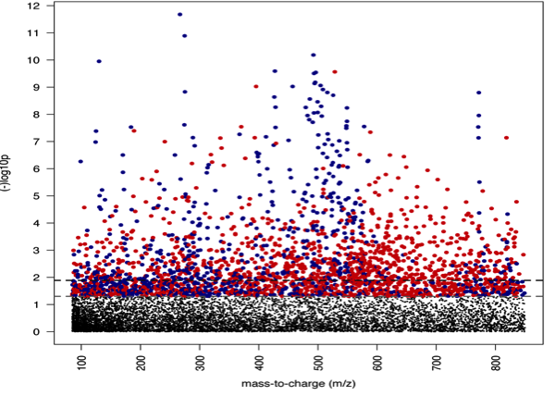
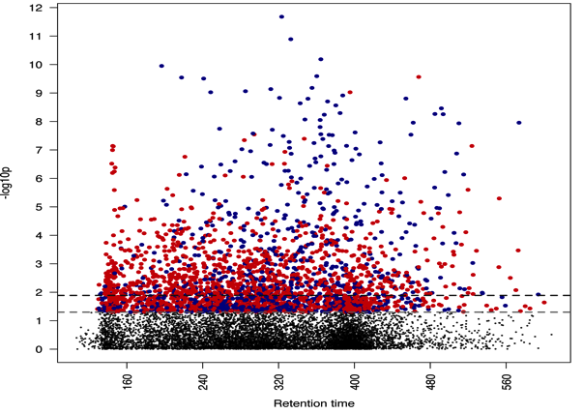
xmsPANDA Manhattan plots: Y-axis corresponds to the –log10 (p-value); FDR cut-off is represented by the horizontal line
a) Type 1: -logP vs m/z
b) Type 2: -logP vs time
m/z
Retention time

Slide 24
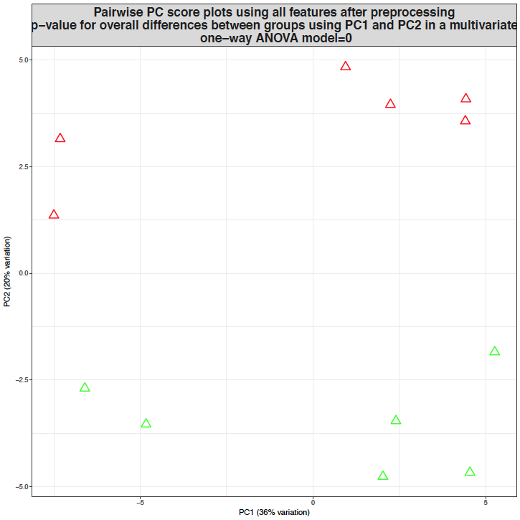
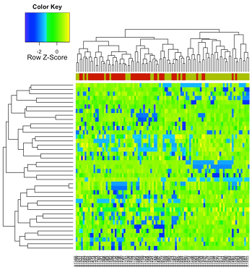
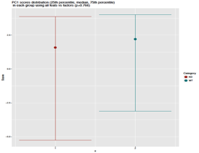
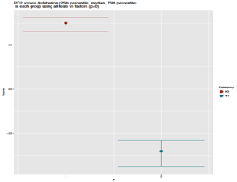
Principal Component Analysis
(PCA)
Hierarchical clustering Analysis
(HCA)
Samples
PC2
m/z features
PC1
Class ~ PC1
Class ~ PC2

Slide 25
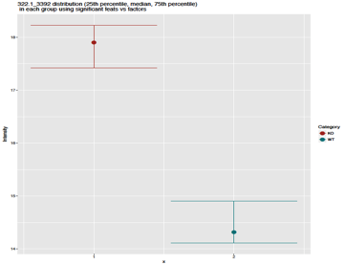
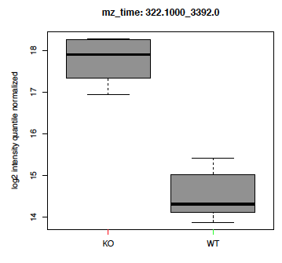
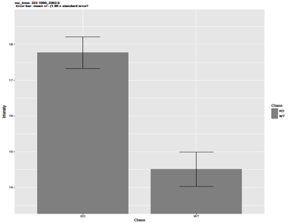
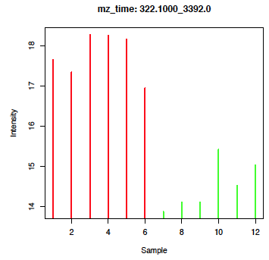
A variety of plots are generated at the feature level

Slide 26
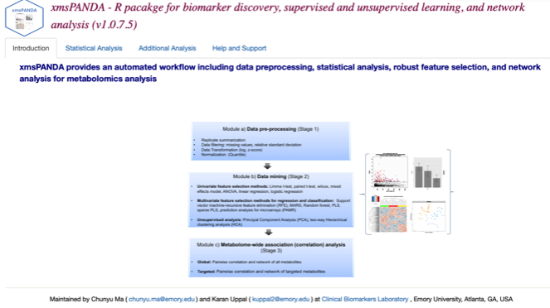
Shinyapp for xmsPANDA v1.07.5
https://kuppal.shinyapps.io/xmspanda/

Slide 27
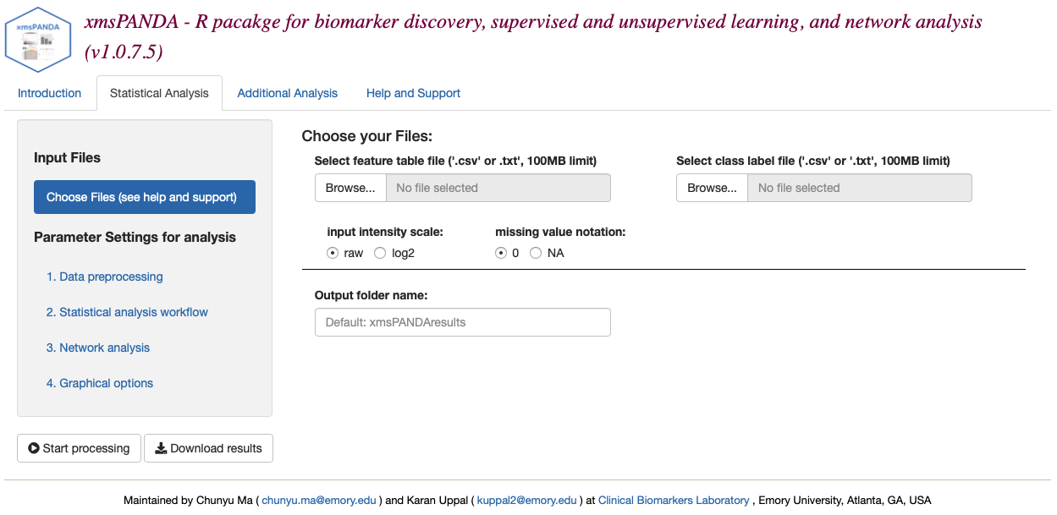
Upload input files

Slide 28
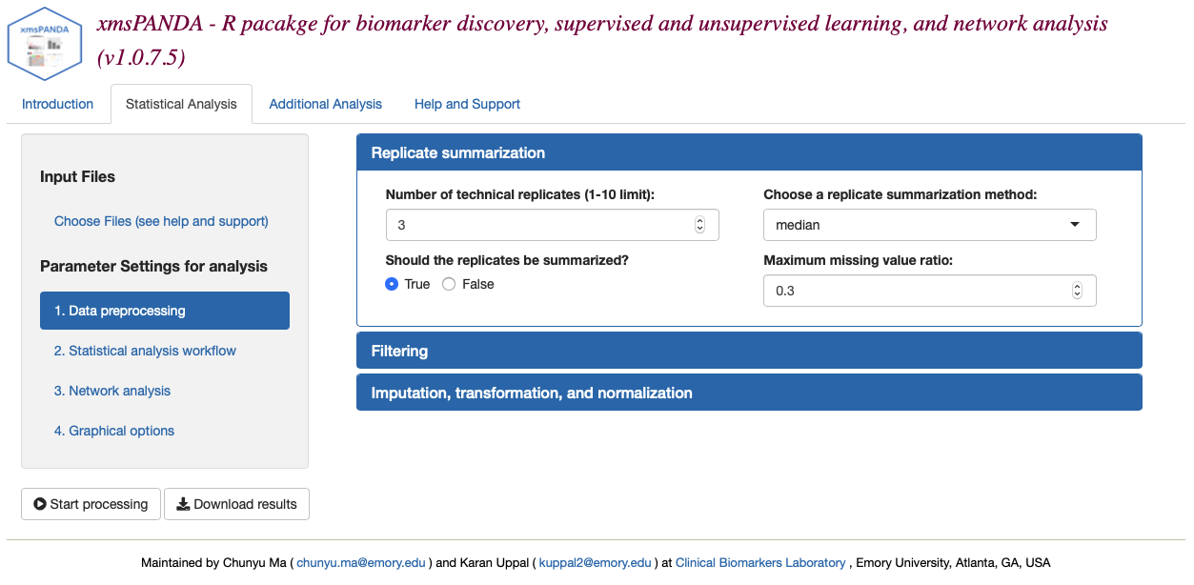
Data preprocessing options - I

Slide 29
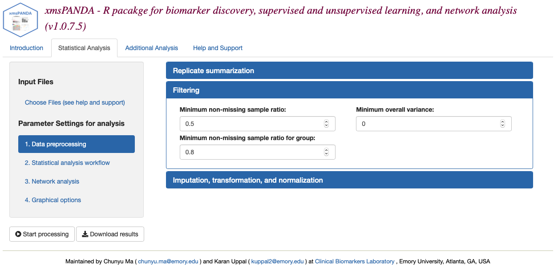
Data preprocessing options - II

Slide 30
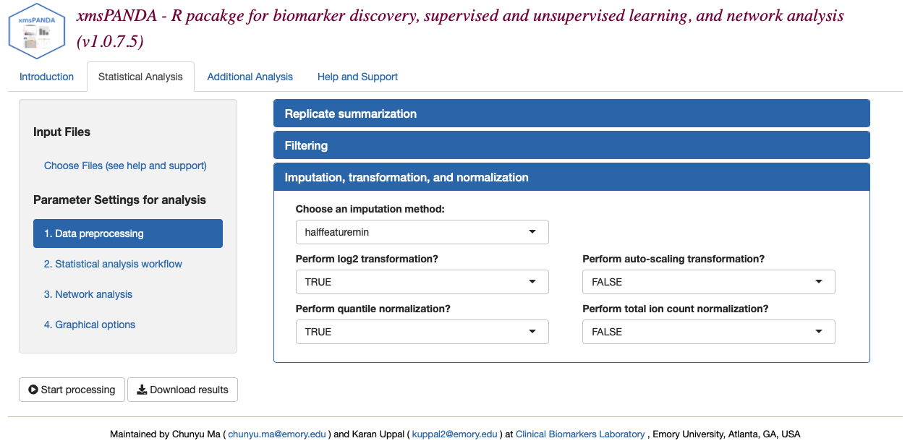
Data preprocessing options - III

Slide 31
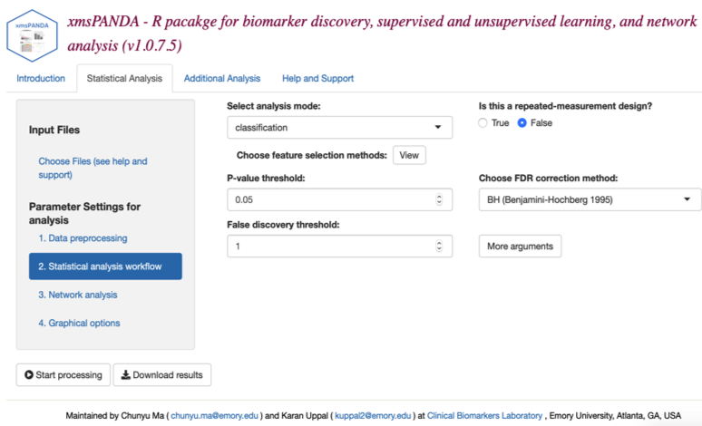
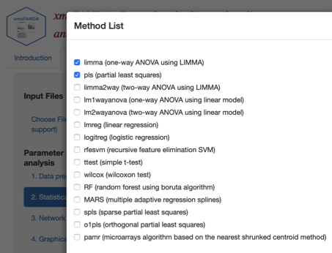
Feature selection options

Slide 32
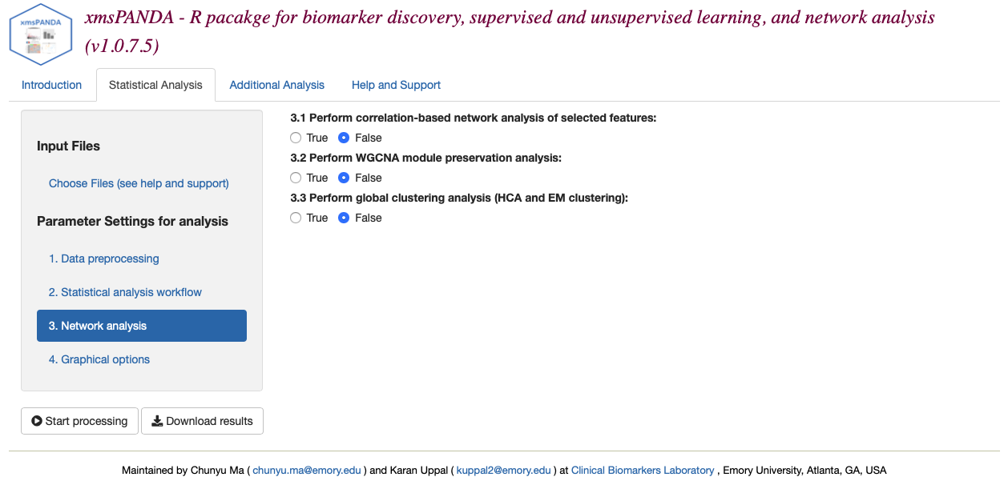
Network analysis options

Slide 33
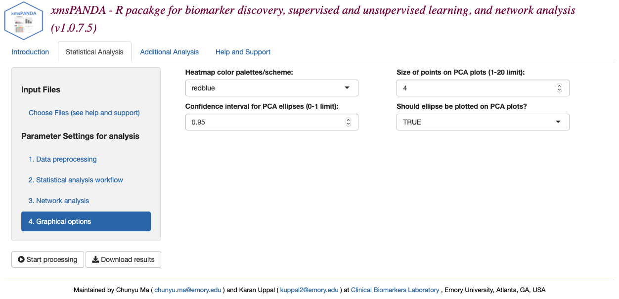
Graphical options

Slide 34
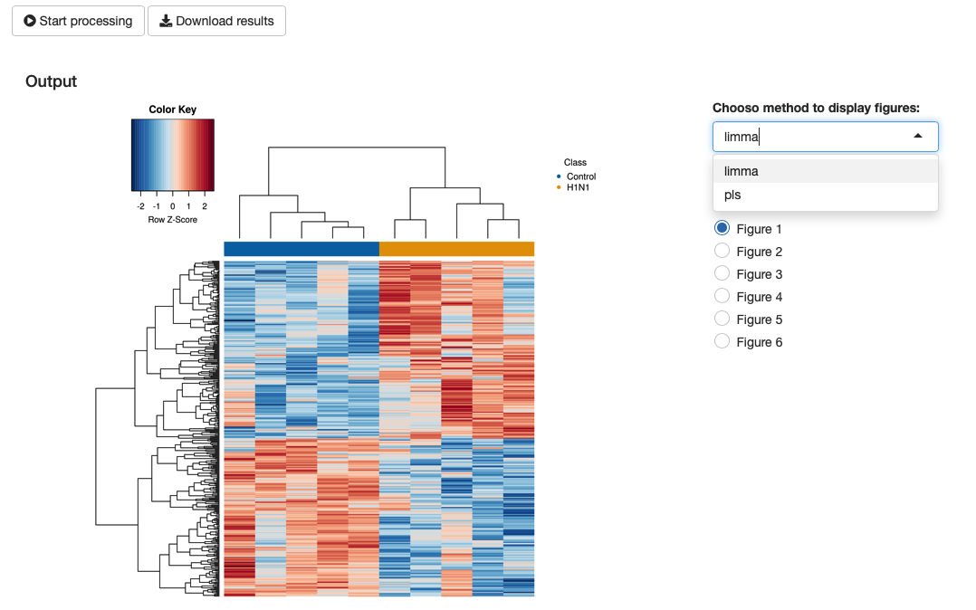
Click on ”Download results” to save the output

Slide 35
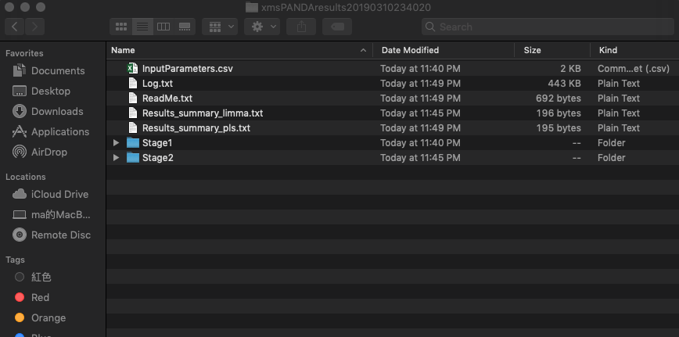
Explanation for Output Files - I
1. ‘InputParameters.csv’records list of input parameter provided to xmsPANDA.
2. ‘Log.txt’ records version numbers of all packages in your working environment and other working information.
3. ‘ReadMe.txt’ is a file explaining each stage outputs.
4. ‘Results_summary_*.txt’ records basic statistical information for the method that you selected.
E.g. 1) #features after filtering
2) #significant features
3) Cross-Validation accuracy
…...
5. ‘Stage1’ folder contains:
1) ordered class label file
2) post-processing feature table
6. ‘Stage2’ folder contains some subfolders for different methods you selected.

Slide 36
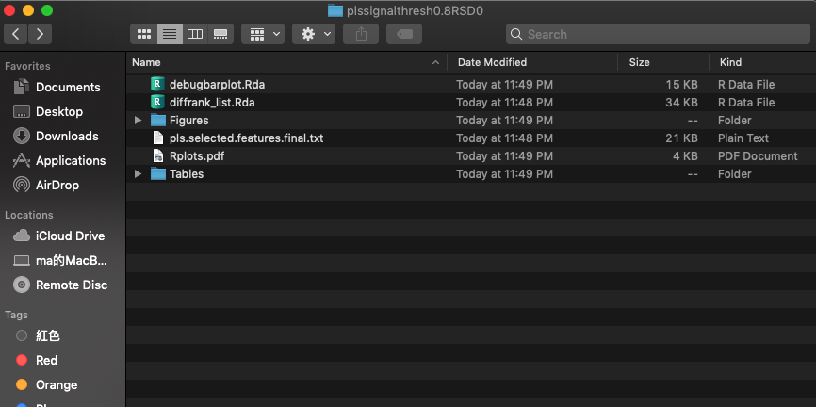
Explanation for Output Files - II
1. ‘Figures’ folder contains all figure files.
E.g. 1) Manhattan Plots
2) HCA Plot
3) Volcano Plot
4) Boxplots & Barplots
……
2. ‘Tables’ folder contains all output analysis results.
3. This file is the final analysis result table containing log2 fold change, P-value/VIP, FDR, log2-transformed intensities for each significant feature.

Slide 37
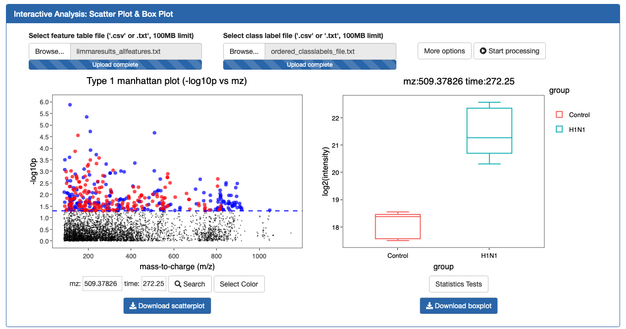
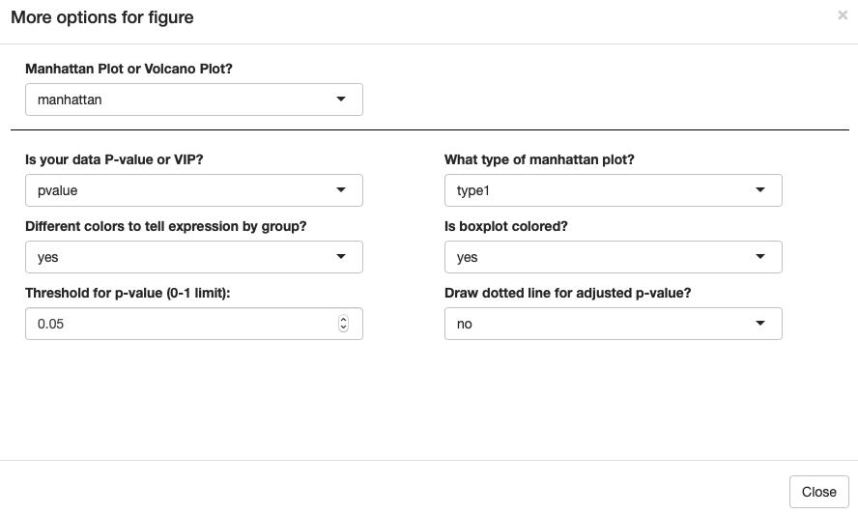
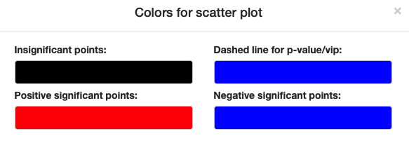
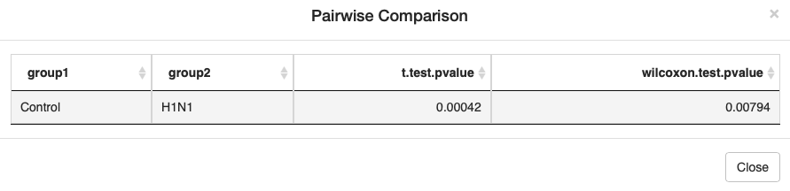
Additional analysis -- interactive analysis
1
2
2
3
4

Slide 38
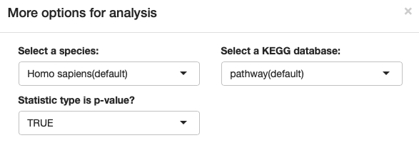
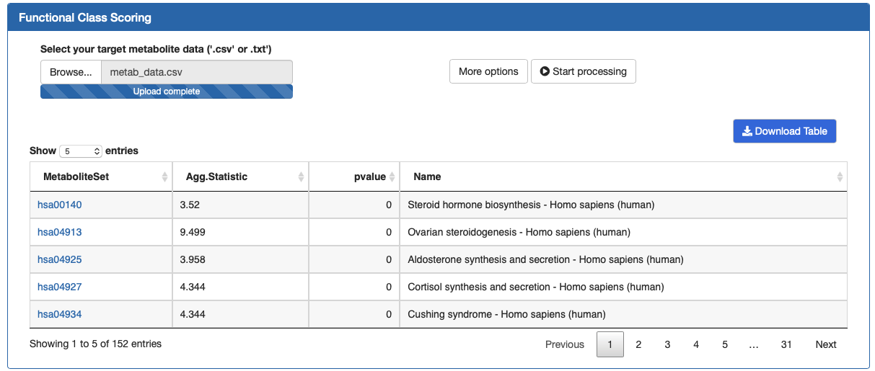
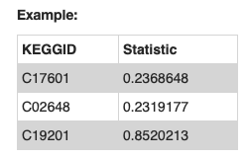
Additional analysis -- Functional Class Scoring

Slide 39
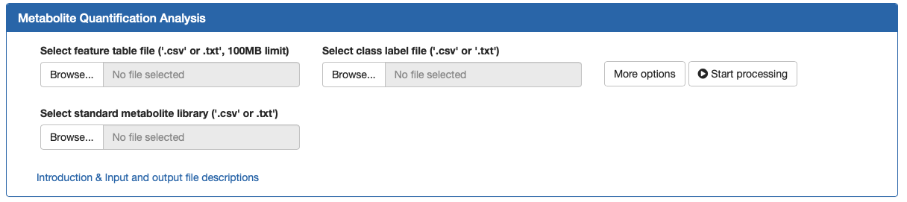
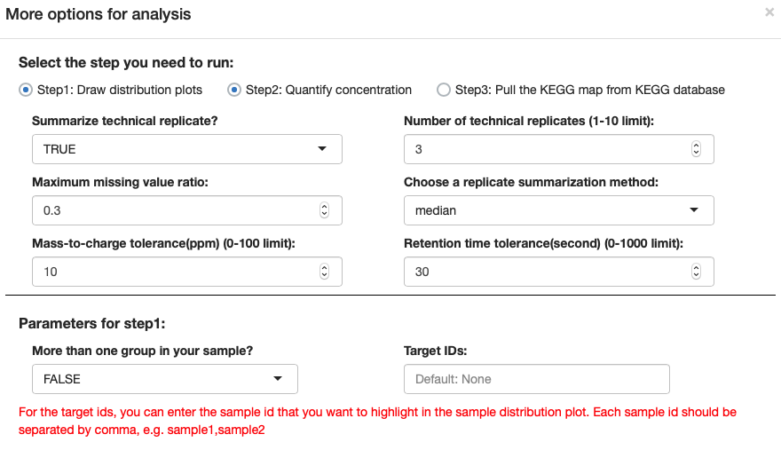
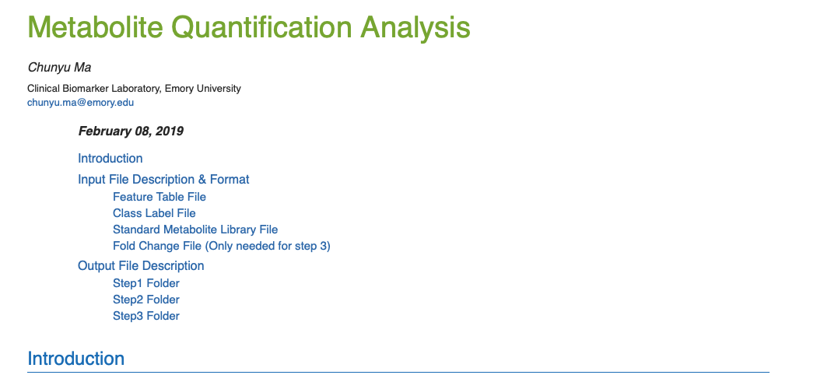
Additional analysis -- Metabolite Quantification Analysis

Slide 40
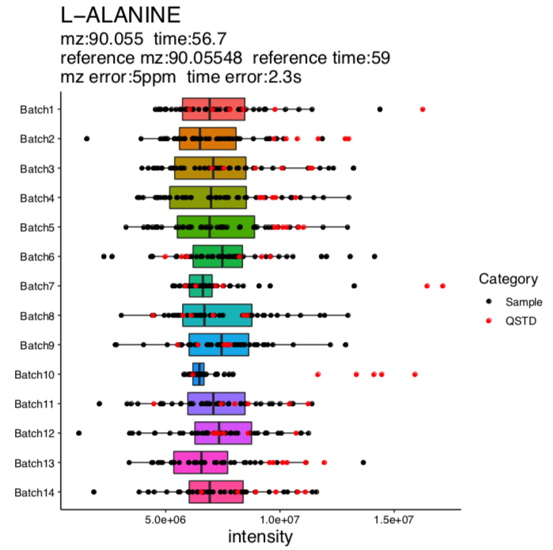
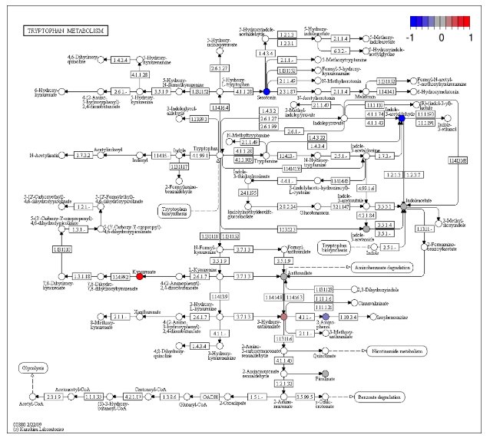

Metabolite Quantification Analysis Results
Step1: Draw distribution plots
Step3: Pull the KEGG map from KEGG database
Step2: Quantify concentration

Slide 41

Correlations in metabolomics
Metabolite concentrations do not vary independently and are organized into highly interconnected networks (Steuer 2003)
Metabolome-wide association studies (MWAS; Jones 2012, Go 2015):
Correlation/association analysis
Untargeted: Pairwise correlations with all metabolites
Targeted: Pairwise correlations with specific (selected) metabolites corresponding to environmental exposures, biomarkers, etc.
Go et al. Metabolome-wide association study of phenylalanine in plasma of common marmosets.
Amino Acids 2015

Slide 42


Correlation-based network analysis
Pearson correlation: measure of the strength and direction
(- or +) of the association between two variables
Normality assumption
Better when there is a
linear relationship
Sensitive to outliers
Partial Pearson correlation: correlation between two variables once the linear effect of p-2 variables has been removed (Graphical Gaussian Models)
Spearman correlation: non-parametric version of Pearson correlation based on the ranks of the original variables to assess monotonic (linear or non-linear) relationships
where d_{i} is the difference between ranks of x_{i} and y_{i}; n is the number of samples

Slide 43

MetabNet (R package)
Targeted MWAS of specific metabolites (biomarkers, environmental exposures, etc.) to facilitate detection of their related metabolic pathways and network structures
Correlation-based network analysis
Each node corresponds to metabolites and the edges correspond to the correlation coefficient, C_{ij}
Two metabolites are linked if |C_{ij}|> threshold at a user defined significance level
Pearson, Spearman, and partial correlation
Targeted metabolites
Metabolites correlated with the targets at |C_{ij}|>t
and p<alpha
Uppal et al. (Frontiers in Bioengineering and Biotechnology 2015)

Slide 44
Input files
Feature table
Target list of m/z
m/z for metabolites can be obtained using the “Advanced Search” feature in Metlin by using KEGG ID or chemical name
Tutorial
https://sourceforge.net/projects/metabnet/files/Tutorial_files/
mz | time | Sample1 | Sample2 | Sample3
175.1188 | 120 | 11091414 | 34091414 | 613135
mz | Name
175.1188 | Arginine
150.0534 | Methionine

Slide 45
Summary
Metabolomics data analysis involves multiple layers of data preprocessing, statistical analysis, and visualization
MetaboAnalyst and xmsPANDA allow data preprocessing, feature selection, and predictive and network analysis capabilities
MetabNet allows Pearson and Spearman correlation analysis

Slide 46
References
https://www.nature.com/articles/s41598-017-19120-0
https://www.ncbi.nlm.nih.gov/pubmed/29762782
https://www.ncbi.nlm.nih.gov/pmc/articles/PMC3299976/
https://www.jstatsoft.org/article/view/v036i11/v36i11.pdf
https://www.ncbi.nlm.nih.gov/pmc/articles/PMC5687754/

